Slide 1
Power BI Adoption Framework
Empower every decision maker
How to Manage

Slide 2
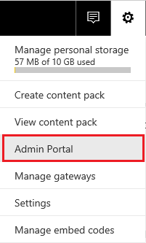
Admin Portal
Power BI Admin or Global Admin O365 Role

Slide 3




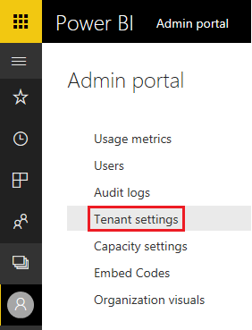




Tenant Settings
Export and Sharing Settings
Content Pack and App Settings
Integration Settings
Custom Visual Settings
R Visual Settings
Audit and Usage Settings
Dashboard Settings
Developer Settings

Slide 4
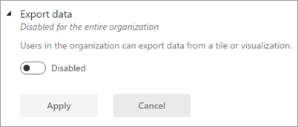
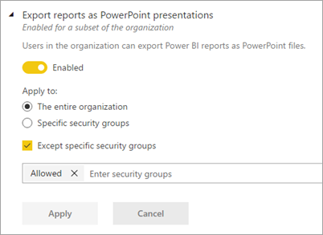
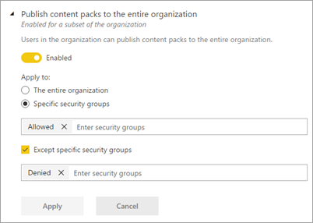
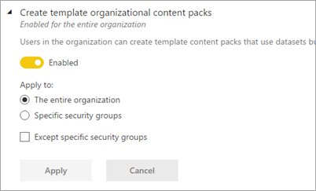
Granular Tenant Settings

Slide 5



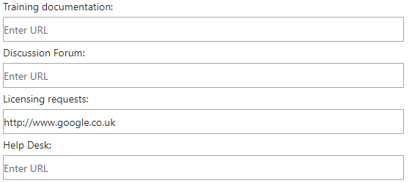


Learn
Community
Get Help
Licensing
Email Notifications
Help and Support Settings
Group Level
Default: Disabled

Slide 6

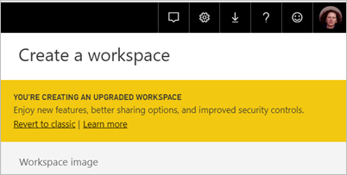

Workspace Settings
Create
Datasets
Group Level
Default: Enabled

Slide 7


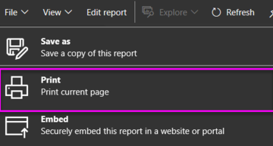


Export PowerPoint / PDF
Print
Email Subscription
Certification
Exporting and Sharing
Organizational Level
Group Level
Default: Disabled
Default: Enabled

Slide 8


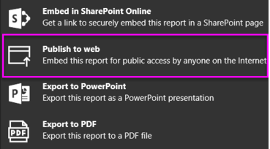


External Users
External Users can Edit
Publish to Web
Export Data
Exporting and Sharing
Group Level
Default: Disabled
Default: Enabled

Slide 9


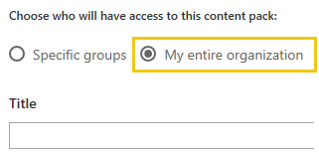

Entire Organisation
Template Apps
Push Apps
Content Pack and Apps
Group Level
Default: Disabled
Default: Enabled

Slide 10

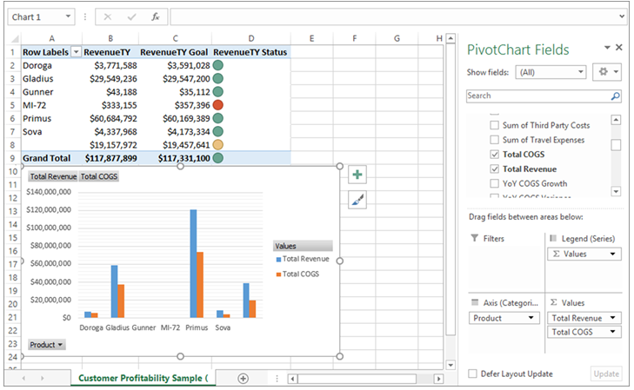

Integration
Analyze in Excel with On-Premises Datasets
ArcGiS Maps
Global Search
Group Level
Default: Enabled

Slide 11


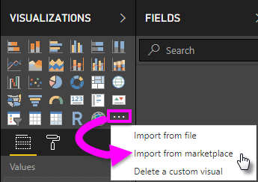
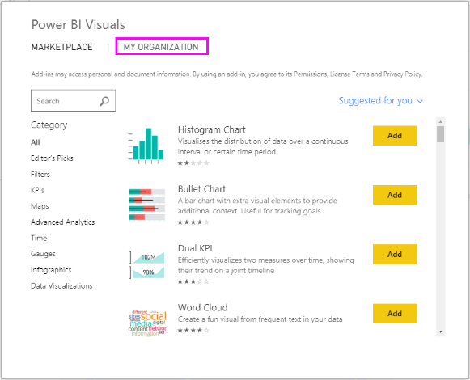

Custom Visuals
Certified Visuals
Organisational Visuals
R Visuals
Custom Visuals
Organizational Level
Group Level
R
Default: Disabled
Default: Enabled

Slide 12


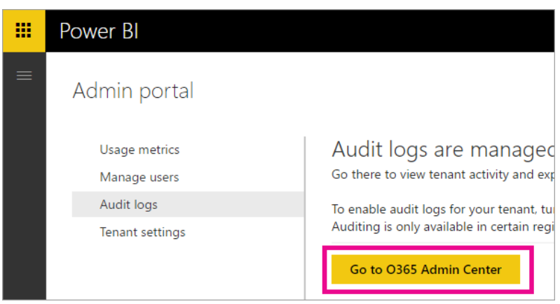

Create Audit Logs
Usage Metrics
Per-user Usage Metrics
Audit and Usage
Organizational Level
Group Level
Default: Enabled

Slide 13

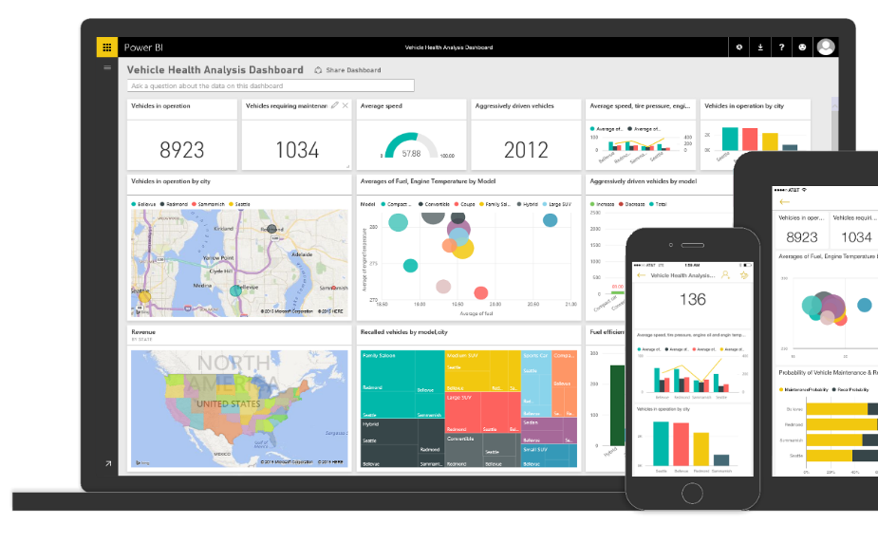
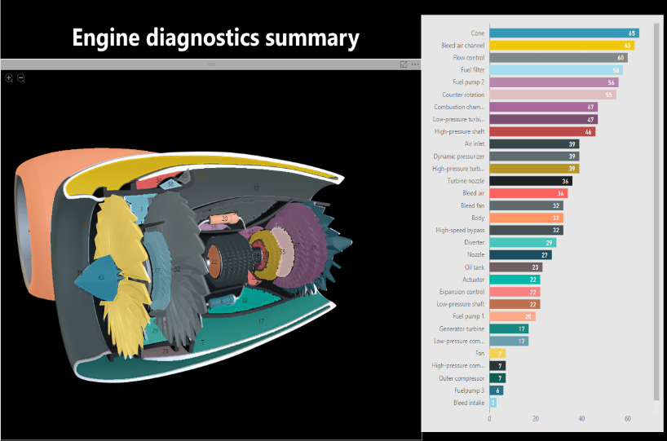

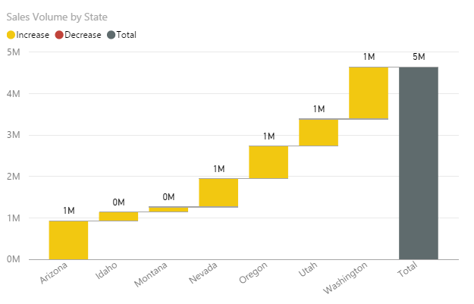
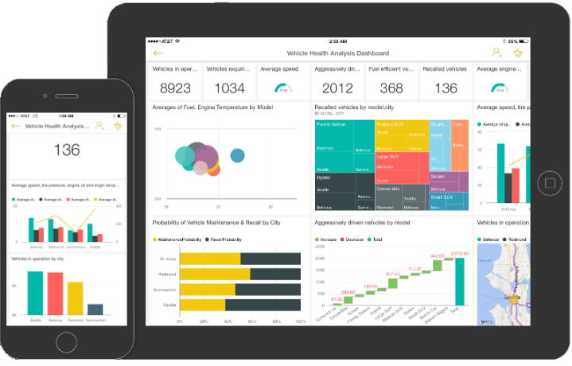
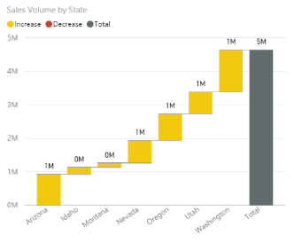

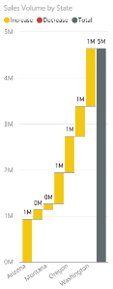

Developer
Embed in Apps
Service Principals
Group Level
Default: Disabled
Default: Enabled

Slide 14


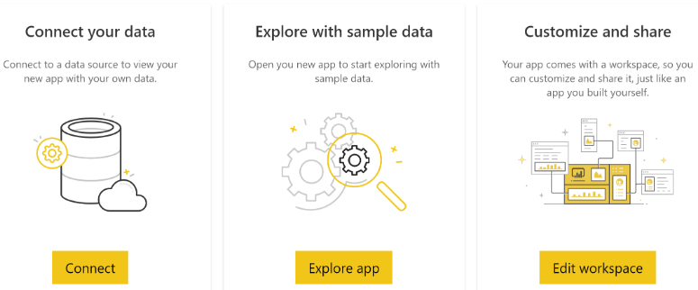

Publish
Install
Install (not listed in AppSource
Template App
Group Level
Default: Disabled
Default: Enabled

Slide 15


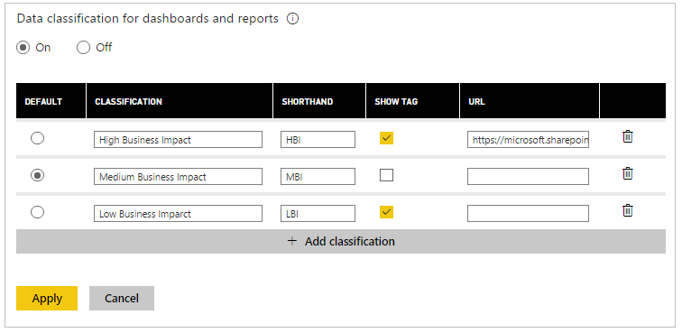

Data Classifications
Q&A
Dataflows
Other
Organizational Level
Group Level
Default: Disabled
Default: Enabled

Slide 16
What should the Power BI Tenant Settings be set to?
Actions
Login to Power BI Service
Select settings gear in the top right
Select Admin Portal
Navigate to Tenant Settings
Configure each setting appropriately

Slide 17
Who will be responsible for administering Power BI tenant settings?
Options
Office 365 Administrators
BI Team
Support Team

Slide 18

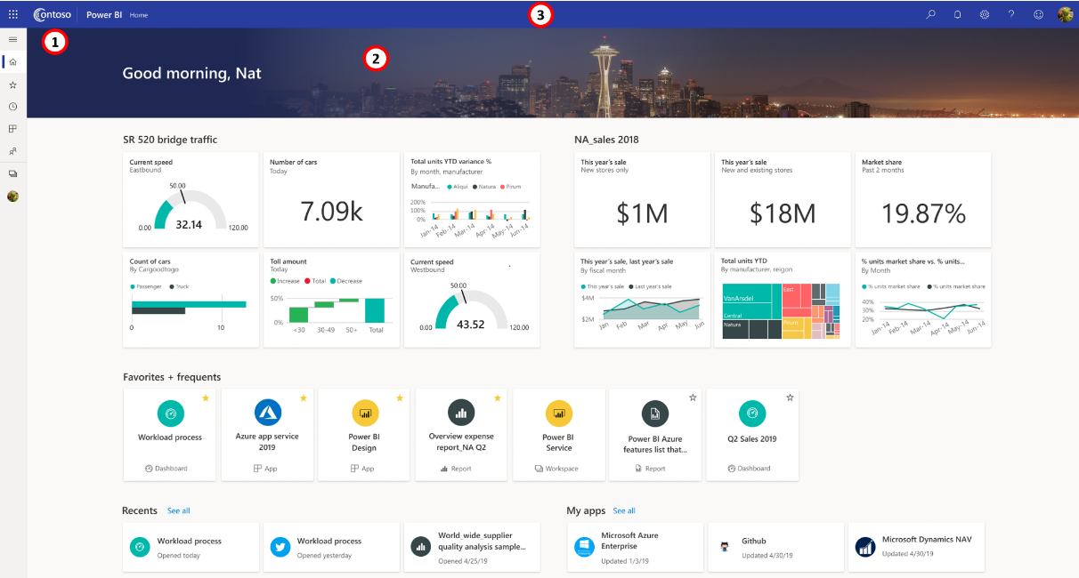

Custom Branding
Theme Colour
Logo
Cover Image

Slide 19
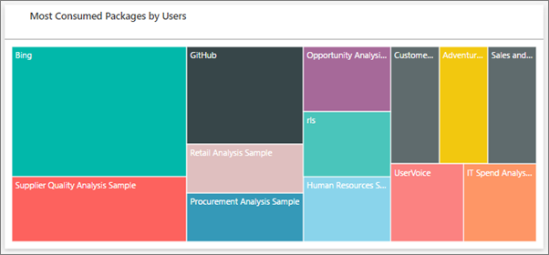
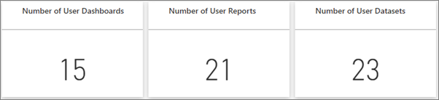
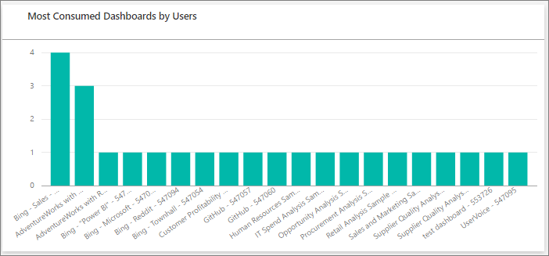
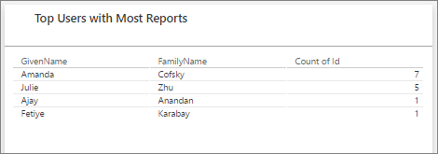
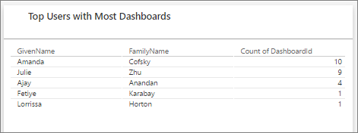
Usage Metrics – Admin Portal

Slide 20
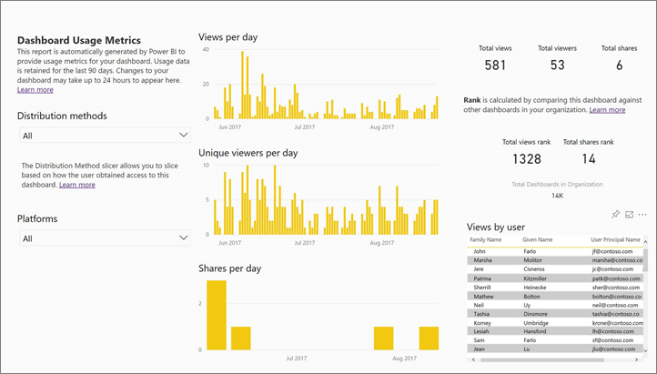
Usage Metrics – Report / Dashboard

Slide 21
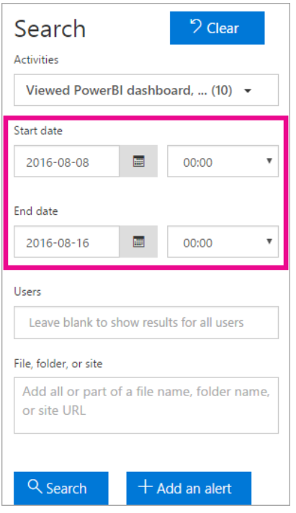
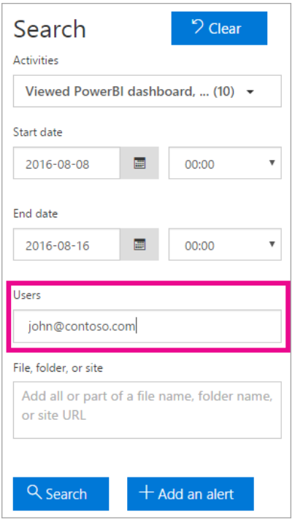
Auditing
O365 Admin Centre
Power BI activities

Slide 22
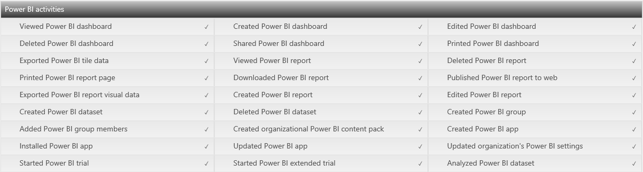
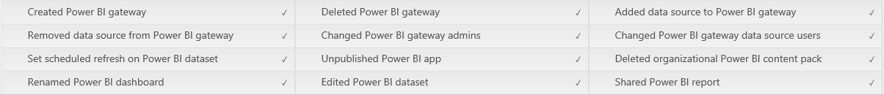
Auditing

Slide 23
How will audit log data be used?
Who will backup the audit log to another location for reporting
Typical roles would be Office 365 admins
Requires View-Only Audit Logs or Audit Logs role in Exchange Online permissions to view audit log
Where will this backup reside?
Azure SQL Database (Recommended)
Blob Storage
How will this backup be created?
Create PowerShell script to extract and automate (Recommended)
Use an Office 365 Audit Reporting Tool or 3rd Part alternative
Navigate to Office 365 Audit Log, filter results for Power BI and export to CSV
Who will create reports on the audit log data?
Typically this would be the BI team
What types of reports can be created from the Audit log?
Users with license not using Power BI – recover license cost
Usage information spanning tenant – monitor all corporate reports and self-service usage (potential candidates to promote)
Regulatory reporting for data leakage, monitoring, etc.
Who will these reports be shared with?
These will be shared with license admins, BI admins or regulatory

Slide 24
Do you require connectivity to on-premises Data Sources?

Slide 25
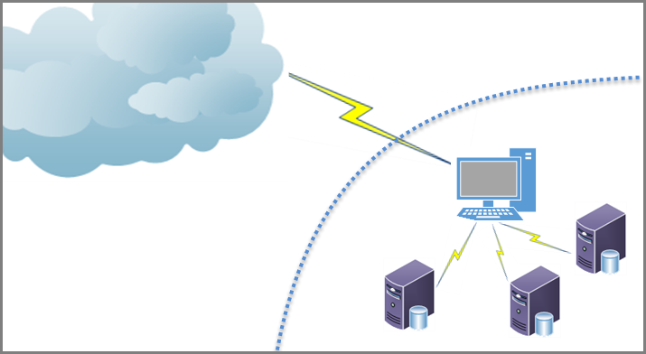
What is an On-premises Data Gateway?

Slide 26
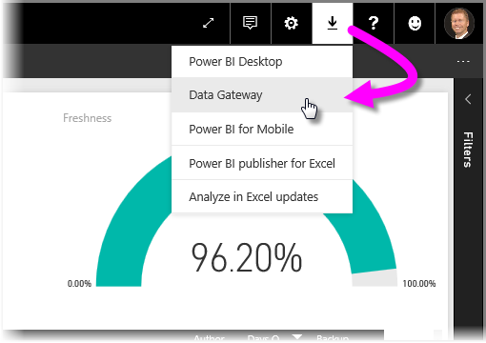
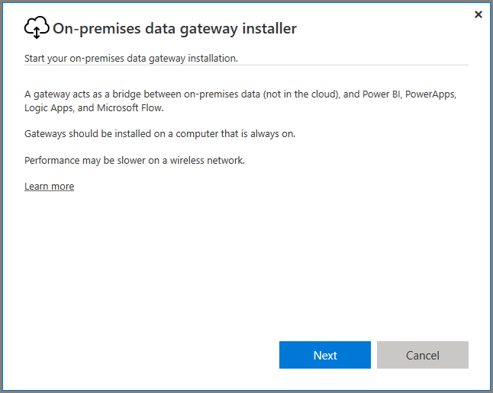
Install an On-premises Data Gateway

Slide 27
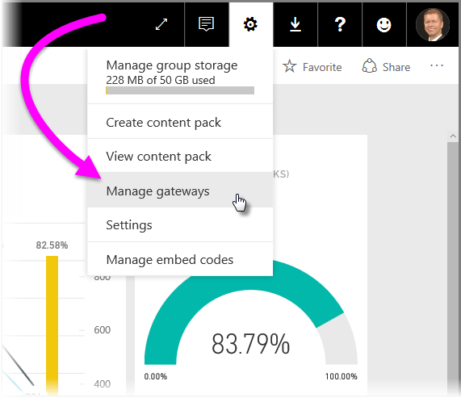
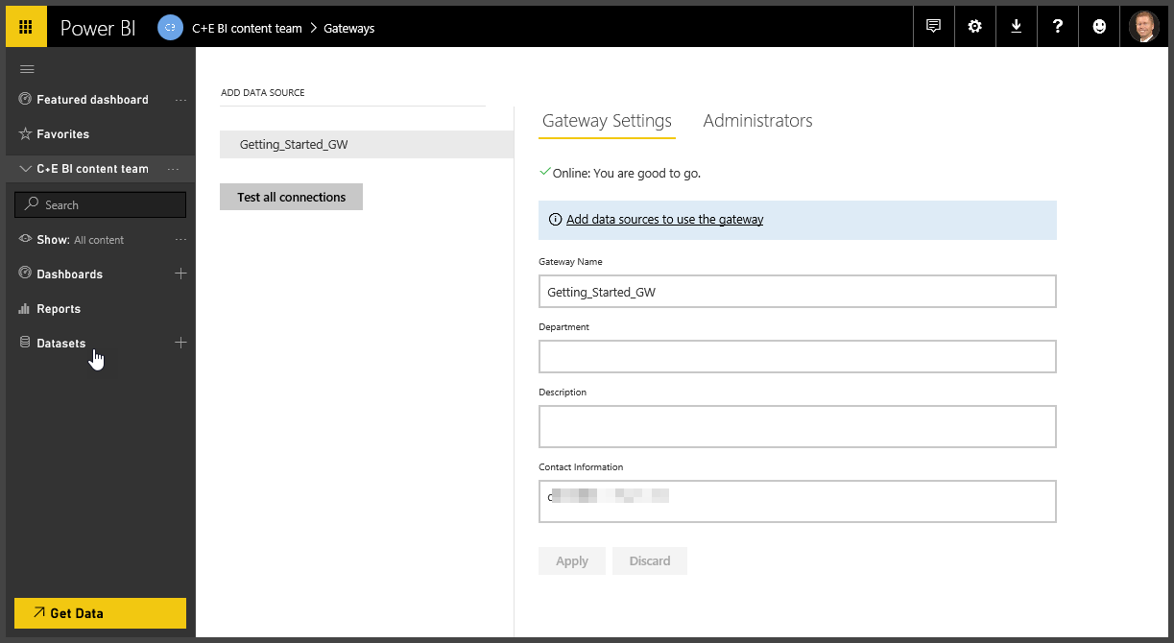
Add users to an On-Premises Data Gateway

Slide 28
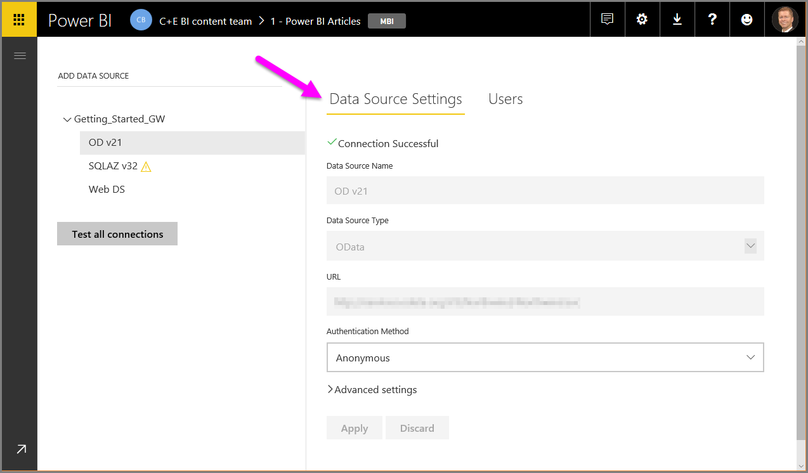
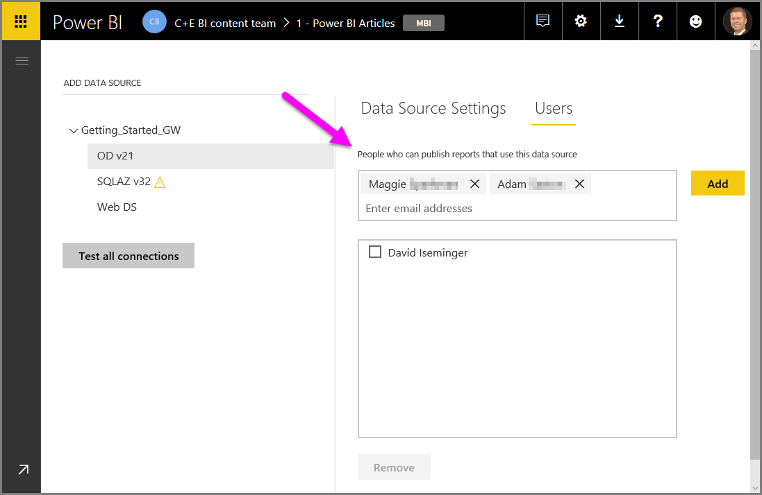
Connect to Data Sources

Slide 29





Guidance for On-Premises Data Gateways
Number of Users
Connection Type
Location
Monitoring
Recovery

Slide 30
Who will be responsible for administering and monitoring Gateways?
Options
Office 365 Administrators
BI Team
Support Team

Slide 31
Where will Gateways be installed and how will they be configured?
Install new Gateway or add Gateway to existing cluster
Creation of new Server / VM – minimum spec
Install software
Backup the Key
Install drivers (if required, e.g. SAP)
Firewall or Port changes
Migrate / add connections if a new gateway
Decide if appropriate and add a user as an admin to a Gateway
They will add Data Sources and Add Users to existing data sources
Add data sources to a Gateway
Add users to a data source on a Gateway
These users can schedule a refresh for this data source using this gateway
Monitor
Use Windows Performance Monitor
Determine Baseline for “Normal” Load
Review slow performing queries by turning on tracing and checking logs
Take Action
Scale the gateway server
Add a new gateway
Add a new cluster to an existing gateway
Feedback to users to change refresh time or performance tune report

Slide 32
Power BI Premium

Slide 33
How will you purchase and configure Premium?
Decide and purchase new Premium nodes
Purchase via Admin Portal or via partner
Decide if appropriate and add a user as an admin to a capacity
Office 365 Global Administrators and Power BI Service Administrators are automatically granted this
Recommend adding BI Team and support to help, reducing dependency on only admins
Grants a user the ability to assign a Workspace to a Premium capacity – users without a Pro license can view content shared to them from that Workspace
Set up a new capacity
Go to Admin Portal in Power BI Service
Go to Capacity Settings
Select Set up new capacity
Select Capacity Size
Consider which Workspaces will be on this Capacity
See When to create an App Workspaces and When to add a Workspaces to Premium

Slide 34
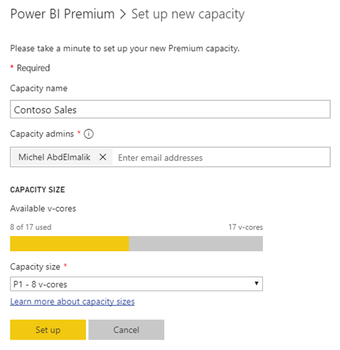
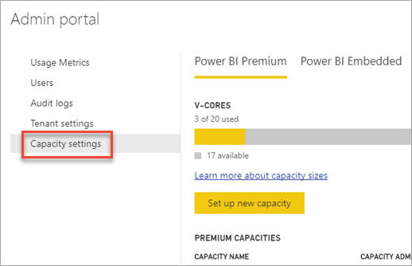
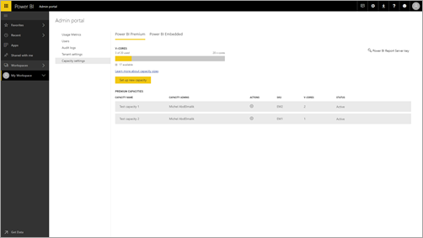
Premium Capacity Management

Slide 35
How to use Premium Capacity- Recommendation
Option | No. Workspaces | Add to Premium | Which Capacity
BI Team Development | 1 | No | All users will have Pro license
BI Team Test | 1 | No | All users will have Pro license If testing is done via an app and Testers do not have a Pro license then Add to Premium
BI Team QA | 1 per report category | Yes | Share a single QA Capacity Small reports share 1 capacity
BI Team Production | 1 per report category / solution | Yes | Share capacity for small reports Important or heavy reports in separate capacity
Business Self-Service Development | 1 per department | No | All users will have Pro license
Business Self-Service Production | 1 per report category / solution | Yes | Share 1 capacity Important or heavy reports should be considered for migration to a BI Team Production workspace

Slide 36
How will you purchase and configure Premium?
Decide and purchase new Premium nodes
Purchase via Admin Portal or via partner
Decide if appropriate and add a user as an admin to a capacity
Office 365 Global Administrators and Power BI Service Administrators are automatically granted this
Recommend adding BI Team and support to help, reducing dependency on only admins
Grants a user the ability to assign a Workspace to a Premium capacity – users without a Pro license can view content shared to them from that Workspace
Set up a new capacity
Go to Admin Portal in Power BI Service
Go to Capacity Settings
Select Set up new capacity
Select Capacity Size
Consider which Workspaces will be on this Capacity
See When to create an App Workspaces and When to add a Workspaces to Premium

Slide 37
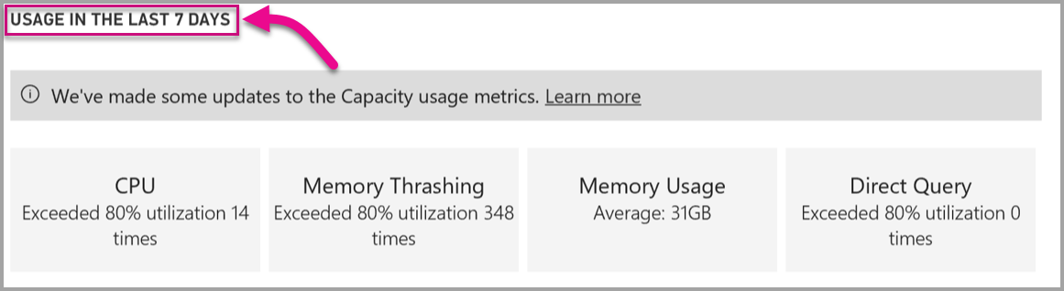
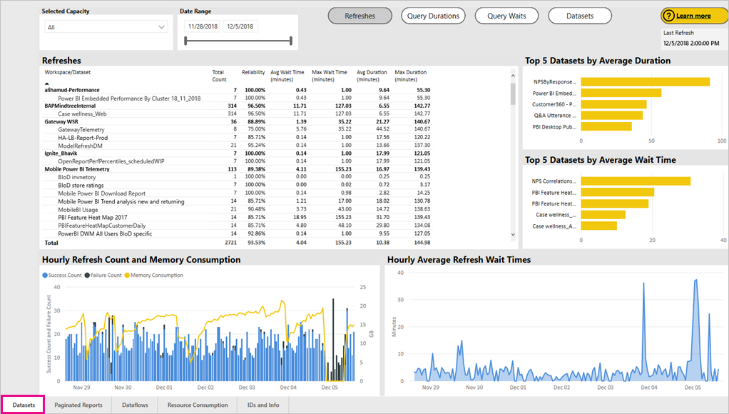
Premium Capacity Monitoring

Slide 38
How will you monitor Premium?
Monitoring a Premium capacity
Install the Premium Capacity Metrics App
In Power BI, click Apps
On the right side, click Get apps
In the Apps category, search for Power BI Premium Capacity Metrics app
Subscribe to install the app
Review Performance
Datasets: detailed metrics on the health of the Power BI datasets in your capacities.
Paginated Reports: detailed metrics on the health of the paginated reports in your capacities.
Dataflows: detailed refresh metrics for dataflows in your capacities.
Resource Consumption: overall capacity metrics including memory and CPU high utilization.
IDs and Info: names, IDs, and owners for capacities, workspaces, and workloads.
Manage and Optimize Premium capacities
Based on monitoring consider the following actions:
Purchase a new Premium capacity
Move workspaces / reports to different capacities
Feedback to users to change refresh time or performance tune report

Slide 39
Thank you

